Slide 1
Hack X200GO sensor data
Rajesh Raveendran

Slide 2
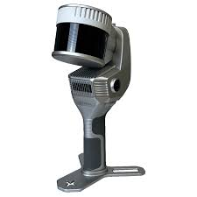
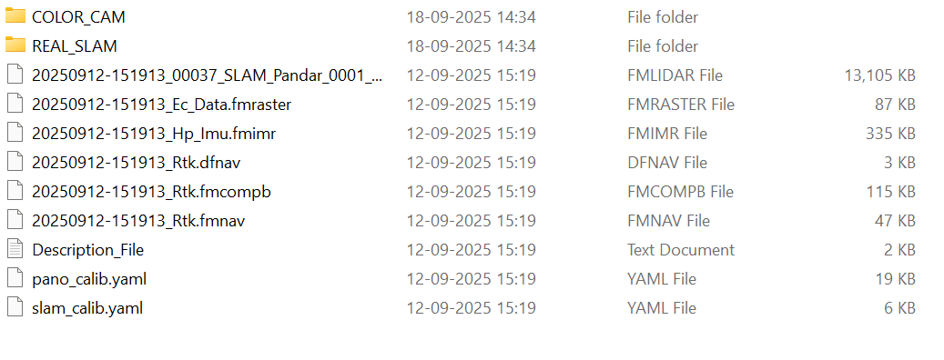
Multimodal 3D modeling Sensor
The sensor has proprietary software for processing raw data, which is also proprietary.
To build software that converts the encoded data from the sensor to a readable format, such as TXT, PCD.
All the metadata has to be taken into consideration for further synchronizing the data.
Proper documentation has to be done.

Slide 3
File parsing
Convert the FMLIDAR to Las/laz/PCD
Convert FMIMR file to txt
Convert FDNAV file to txt
Convert FMCOMPB file to txt
Convert FMNAV file to txt
Convert FMRASTER file jpg / png

